Slide 1

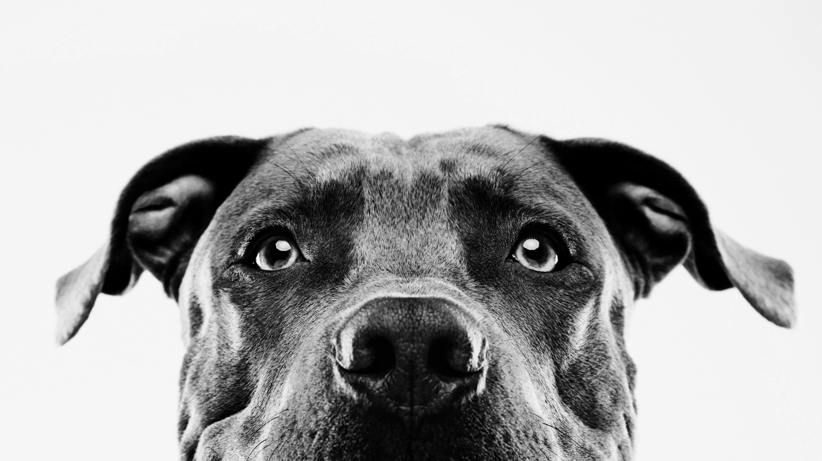

Pet adoption
z
Presented by:
Alexis Rojas
Johanna Belmar
Katharina Sojka
David Spir

Slide 2

Introduction
Our goal is to determine the various factors that influence pet adoption in order to predict which pets are more likely to be adopted. This dataset is imperative in finding solutions focused on increasing pet adoption rates. Therefore, using machine learning to find predictions can be an important tool in finding these solutions.
.

Slide 3
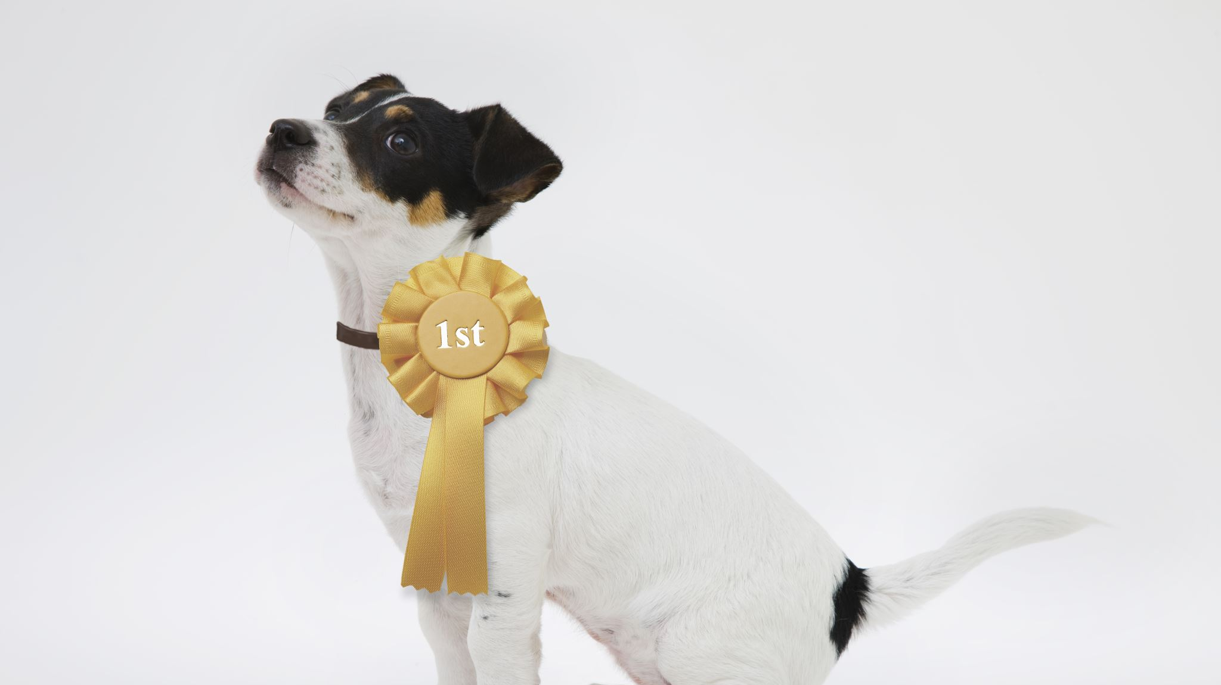
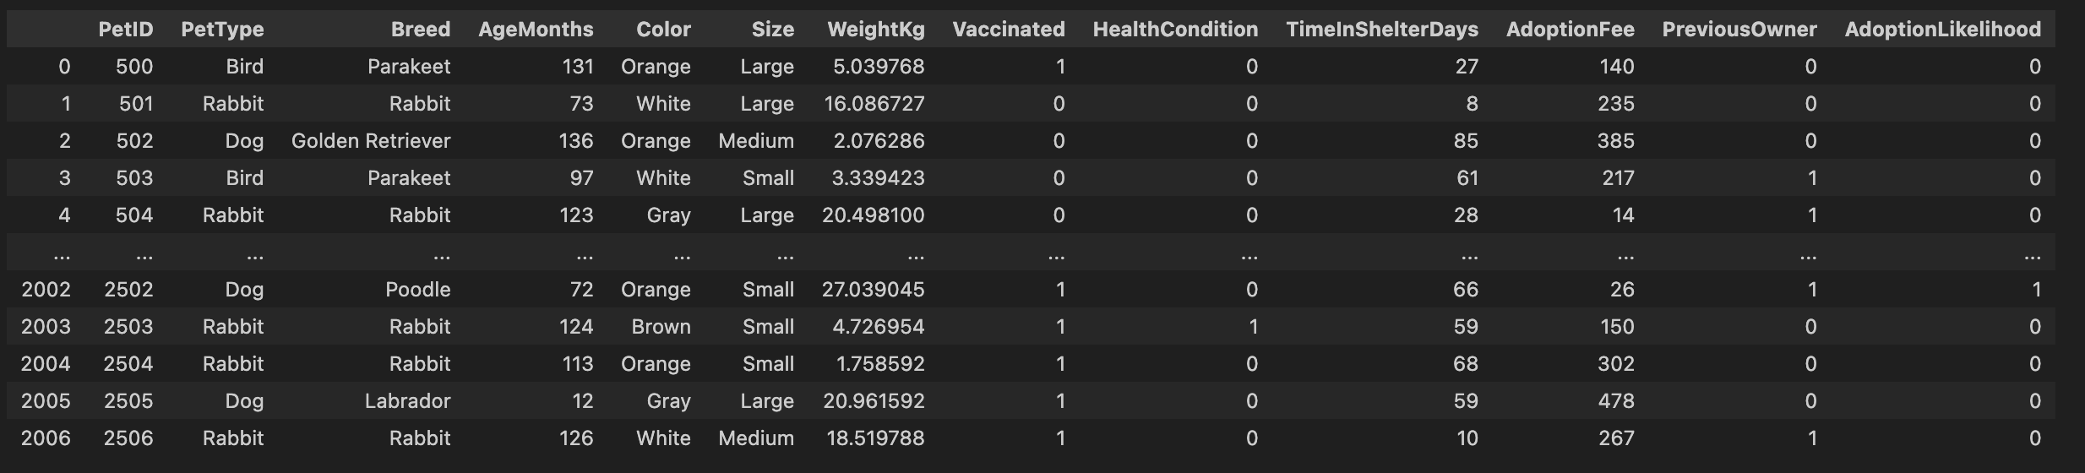
PET ADOPTION DATA
Organized data frame created in jupyter notebook:
1. Adoption Rate by Pet Type: Understand which types of pets are more likely to be adopted.
2. Impact of Age and Weight: Analyze how age and weight impact adoption likelihood.
3. Vaccination and Health: Investigate the role of vaccination and health condition on adoption likelihood.
4. Shelter Time and Adoption Fee: Examine the correlation between time in the shelter, adoption fee, and adoption likelihood.
5. Size and Adoption: Determine if the size of the pet affects adoption rates.

Slide 4

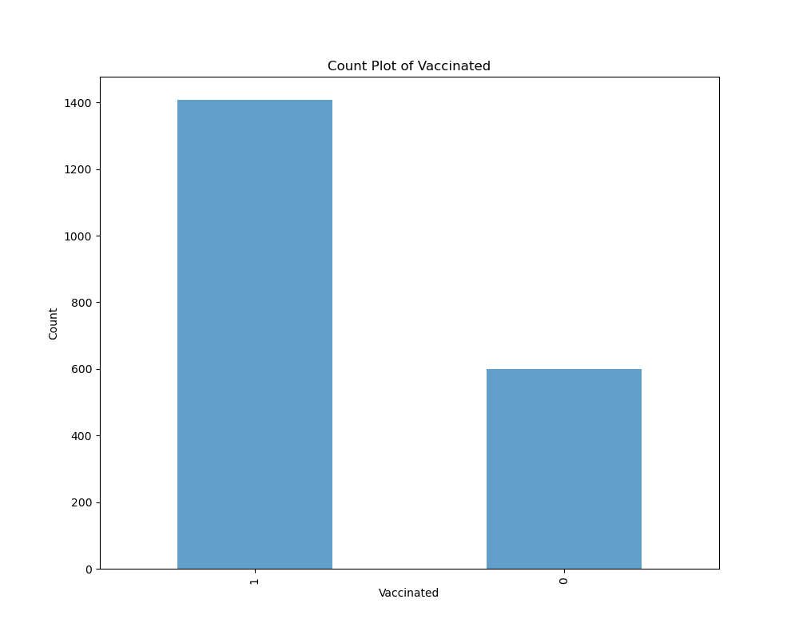


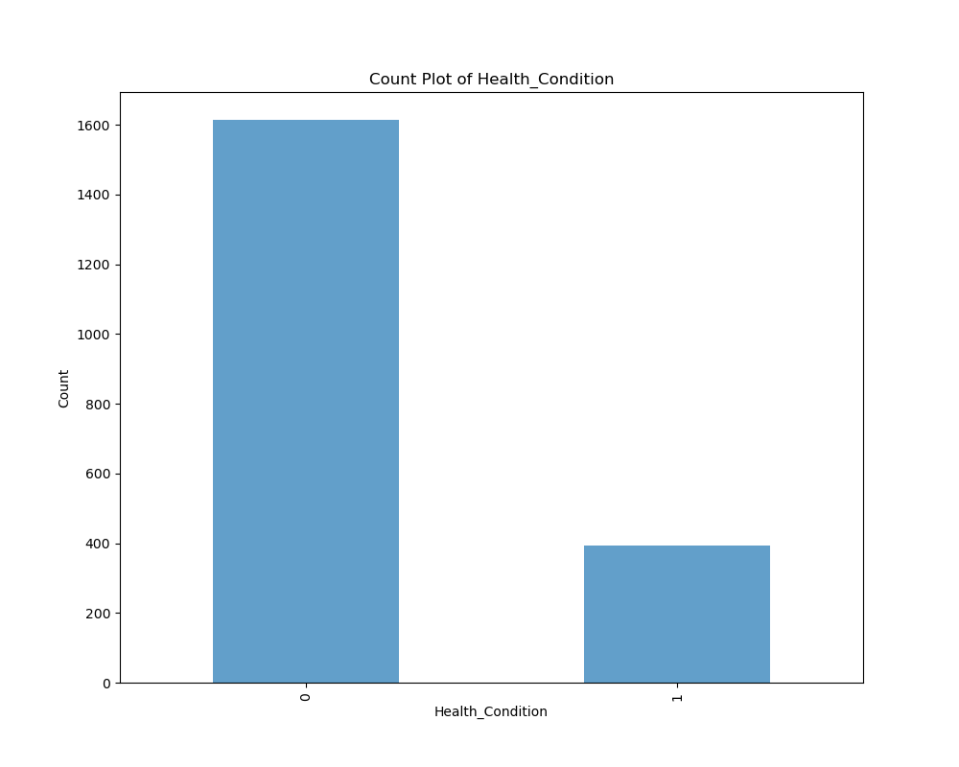


Insights 1. Health Condition: Most pets are healthy (condition-0), which might positively influence adoption likelihood as adopters often prefer healthier pets. 2. Previous Owner: The majority of pets do not have a previous owner, suggesting they might be strays or rescues. This could impact their socialization and adoption readiness. 3. Vaccination Status: The high rate of vaccinated pets is a positive indicator for adopters, as it suggests that the pets are more likely to be healthy and ready for adoption.
z

Slide 5
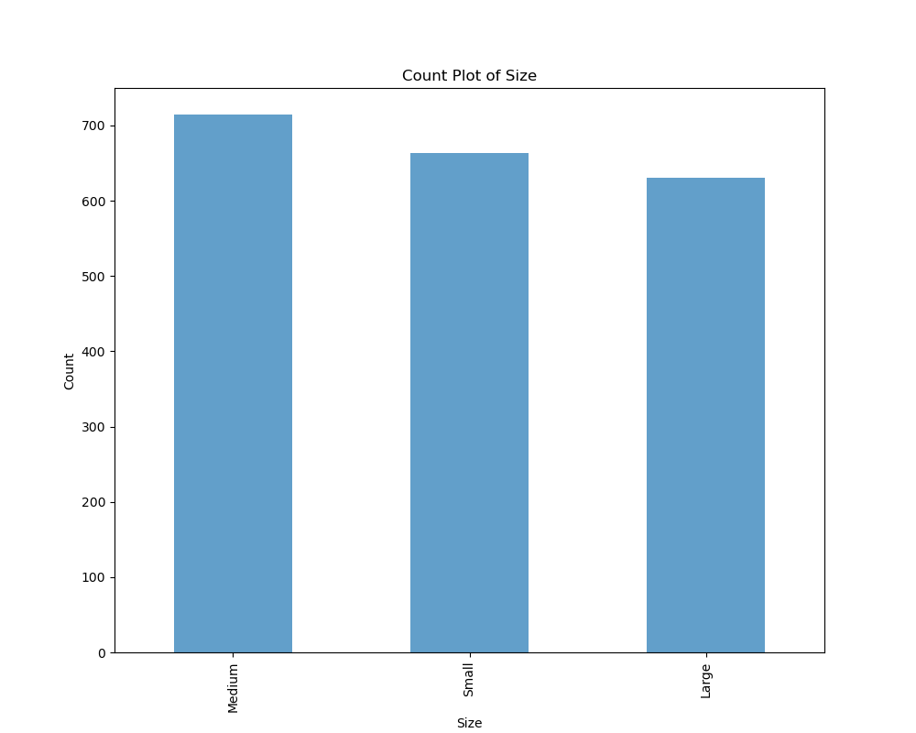
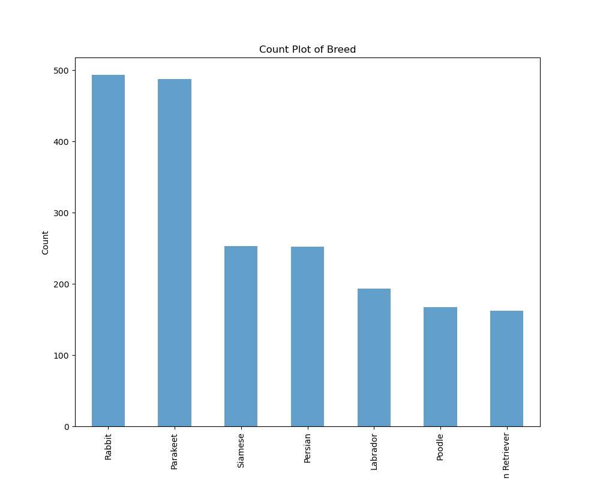
1. Size Distribution: provide useful information for analyzing how the size of a pet might influence its likelihood of being adopted. Further analysis could involve looking at how size interacts with other factors, such as pet type, breed, and health condition, to affect adoption outcomes.
2. Breed Distribution: The high counts for Rabbits and Parakeets could indicate a higher presence of these breeds in shelters, possibly due to their popularity or specific breeding patterns.

Slide 6
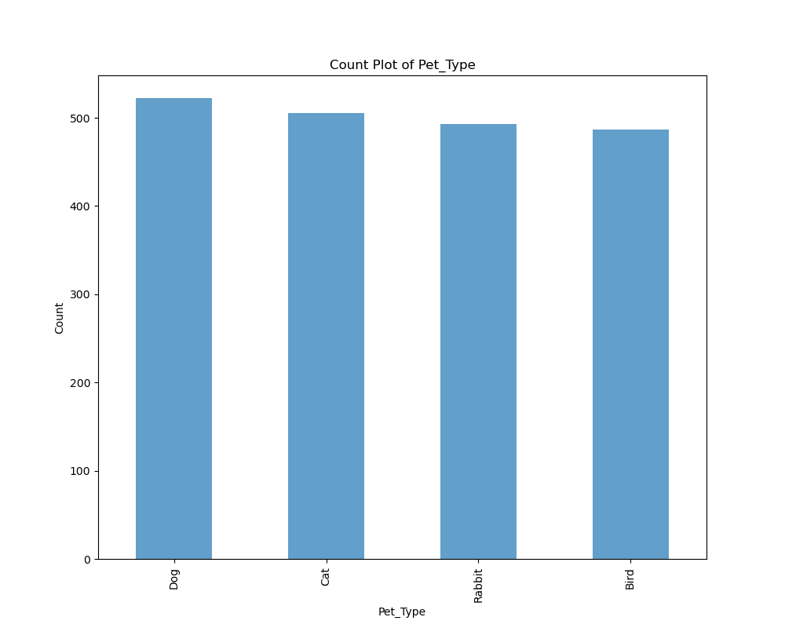
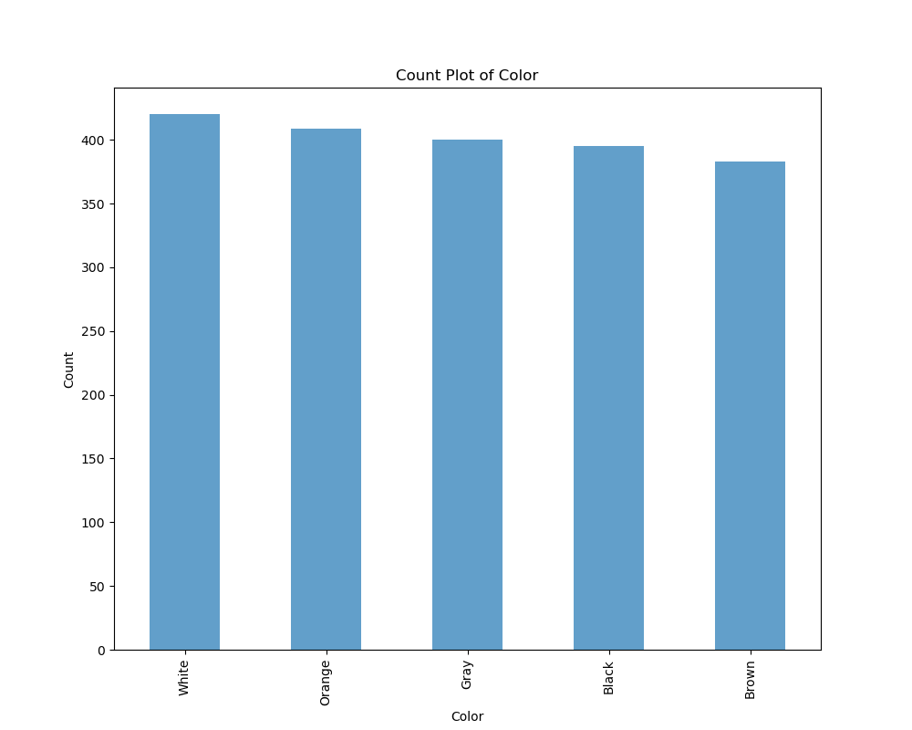
3. Pet Type Distribution: The even distribution of pet types allows for a comparative analysis of adoption rates across different types of pets. 2. Color Distribution: The balanced distribution of pet colors implies that adopters have a wide range of color choices, which may cater to various preferences.
z

Slide 7

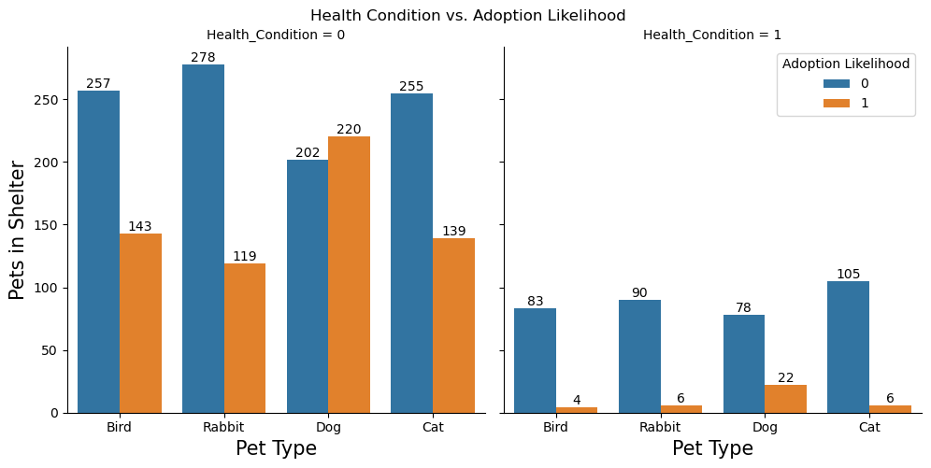
Health condition vs adoption likelihood
This graphic is a bar chart that compares the number of pets in shelters by pet type and adoption likelihood, grouped by health condition. The chart is divided into two main sections, each representing a different health condition
Notes:
This graphic is a bar chart that compares the number of pets in shelters by pet type and adoption likelihood, grouped by health condition. The chart is divided into two main sections, each representing a different health condition

Slide 8
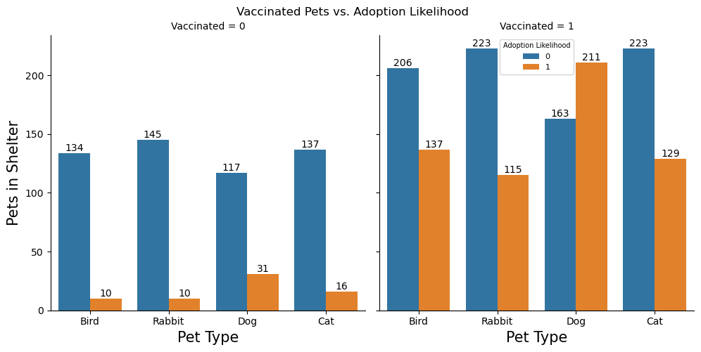
Vaccinated pets vs adoption likelihood
This visual representation highlights the impact of vaccination status on adoption likelihood for different types of pets in shelters. It suggests that vaccinated pets have a higher adoption rate compared to non-vaccinated pets, indicating that vaccination may play a crucial role in increasing the chances of pets being adopted.

Slide 9

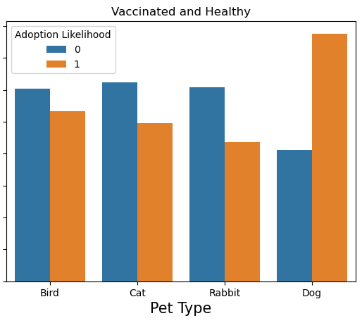
Vaccinated and healthy
This bar chart compares the number of vaccinated and healthy pets in shelters by pet type and their adoption likelihood. The chart presents data for four different pet types: Bird, Cat, Rabbit, and Dog, with two categories of adoption likelihood (0 for not adopted, 1 for adopted) indicated by different colors.

Slide 10
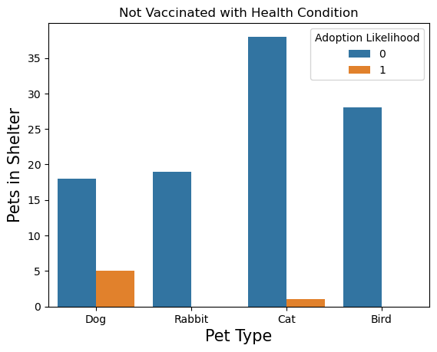
Not Vaccinated with Health Condition
The bar chart shows the number of pets in the shelter that are not vaccinated and have a health condition, categorized by pet type, along with their adoption likelihood.

Slide 11

Methodology
Model selection:
Logistic regression model:
Logistic regression is one of the most straightforward and interpretable models. It provides clear insights into the relationship between the features and the target variable through its coefficients.
Random Forest Model
Random forest is a powerful method capable of capturing complex, non-linear relationships in the data in which Logistic Regression may miss.
Random Forest provides a measure of feature importance, helping to identify which features contributes the most to the prediction, thus providing insights into the data.

Slide 12
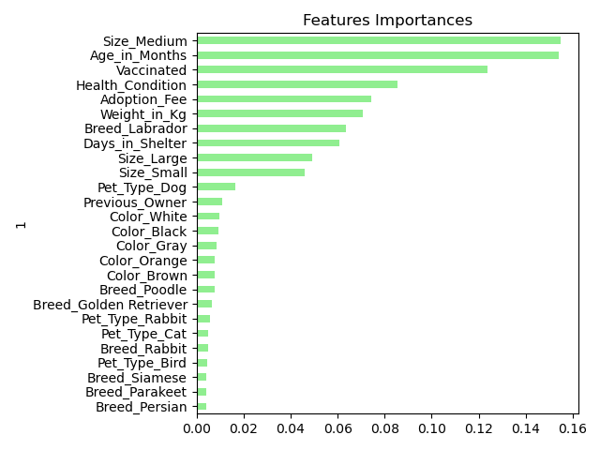
Features Importance
This bar chart represents the feature importance in a machine learning model used to predict pet adoption likelihood. The features are ranked based on their importance, with the most important features at the top and the least important at the bottom. The x-axis represents the importance score, while the y-axis lists the features considered in the model.

Slide 13
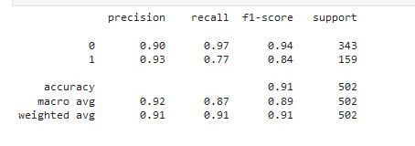
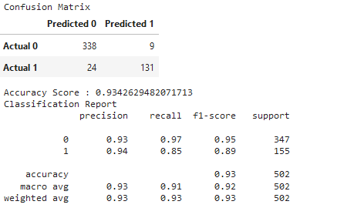
Models: Random Forest vs Logistic Regression
Logistic regression
Both models perform well, but the Random Forest model slightly outperforms the Logistic Regression model in terms of overall accuracy (0.93 vs. 0.91) and the balance between precision and recall, particularly for the adopted class (class 1).
• The Random Forest model has higher precision, recall, and F1-scores for class 1, making it a better model for predicting pet adoption likelihood.
Random forest

Slide 14
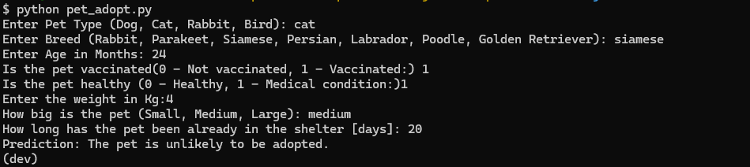
Based on the provided inputs, the app predicts whether the pet is likely to be adopted or not. In the given example, the prediction is that the “pet is unlikely to be adopted”.
z

Slide 15
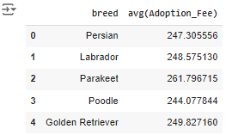
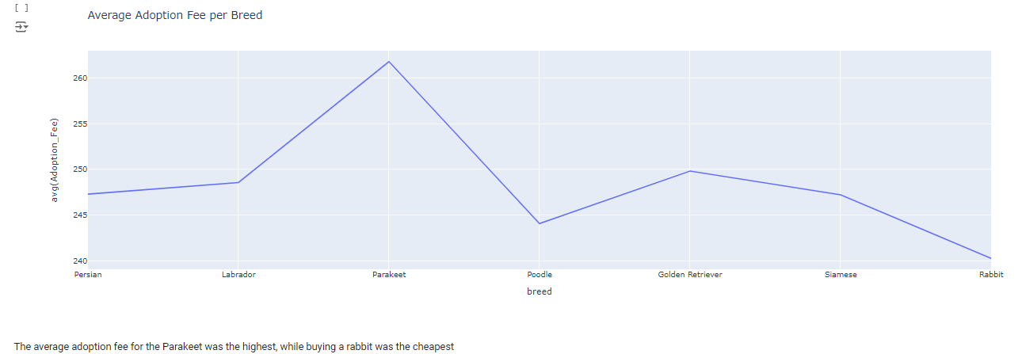
SPARK QUERY AND LINE GRAPH
This analysis can help in understanding how adoption fees vary by breed and provide insights into how financial factors may affect pet adoption.
Average Adoption Fee by Breed: The table displays the average adoption fee for different breeds: • Persian: $247.31 • Labrador: $248.58 • Parakeet: $261.80 • Poodle: $244.08 • Golden Retriever: $249.83

Slide 16
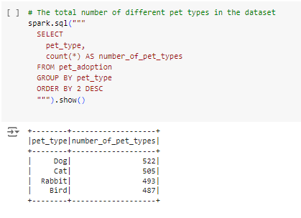
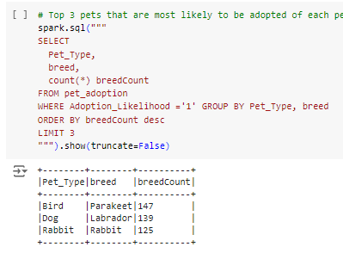
Here’s a breakdown of the query: • SELECT: The query selects pet_type and counts the number of occurrences for each pet type, aliased as number_of_pet_types. • FROM: The data is retrieved from the pet_adoption table. • GROUP BY: The results are grouped by pet_type. • ORDER BY: The results are ordered by the count in descending order (DESC).
SQL QUERIES
z
Here’s a breakdown of the query: • SELECT: The query selects pet_type and the breed and counts the different types of breed for each pet type where they were likely to be adopted. The data is retrieved from the pet_adoption table. • GROUP BY: The results are grouped by pet_type. • ORDER BY: The results are ordered by the count in descending order (DESC). Showing the top 3

Slide 17

Conclusion:
Performing certain tasks like the logistic regression model, creating bar graphs for comparisons, the features importance graph, and using spark, gave us an insight on what certain factors owners look for in adopting. We noticed that certain factors such as medium sized pets, age in months, vaccinated/health conditions, etc. do take part in a pet's adoption likelihood. Using logistic regression model and random forest model, we found that our prediction was 91% and 93% accurate respectively. The precision score predicting whether the pet would be adopted or not were very similar.

